Slide 1

pharminder
Find your medicine

Slide 2
proposal
Our service is developed for everyone who is searching for a specific medicine in an area near to them.
The user is able to access a set of different pharmacies in order to find their needed medicine and discover the nearest pharmacy to them.
It will be developed to run on web browsers and Android devices.

Slide 3
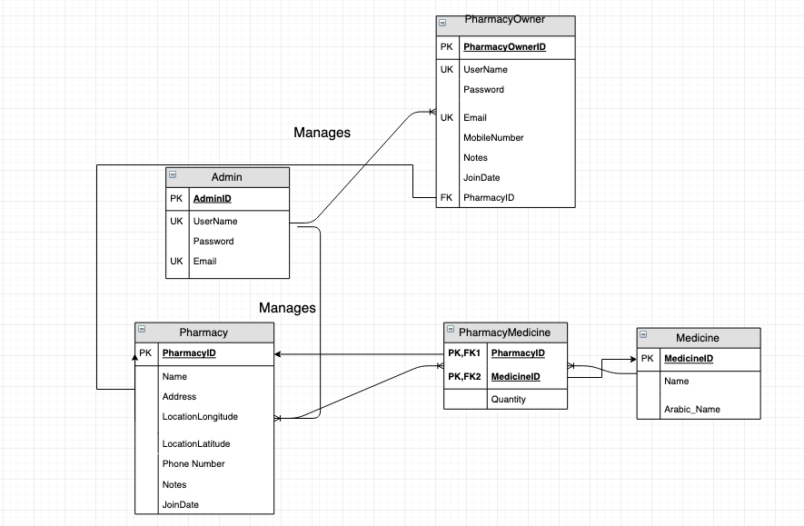
ERD diagram

Slide 4
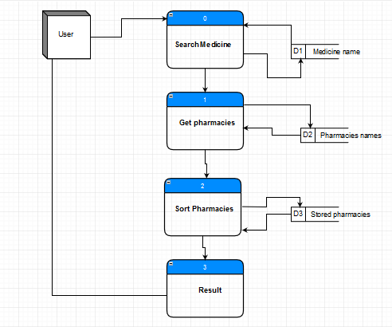
DFD

Slide 5
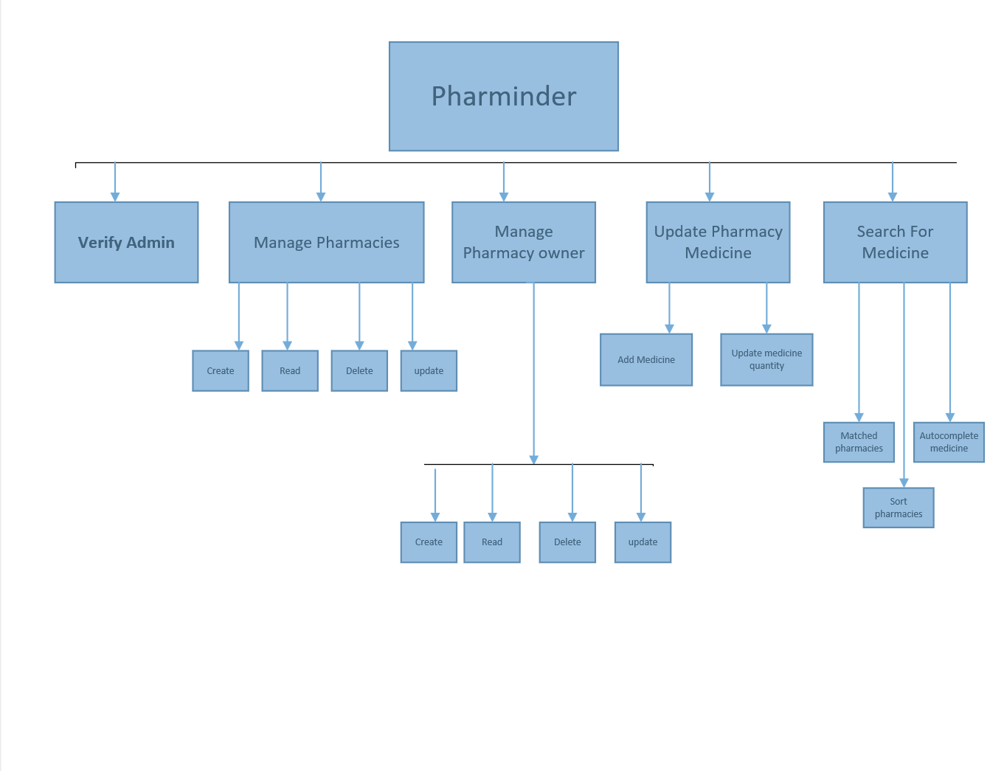
FDD

Slide 6
The project interfaces
Search page
Admin login
Admin forms
Medicine form
Pharmacies form
Pharmacy owners
Search result

Slide 7

Search page

Slide 8
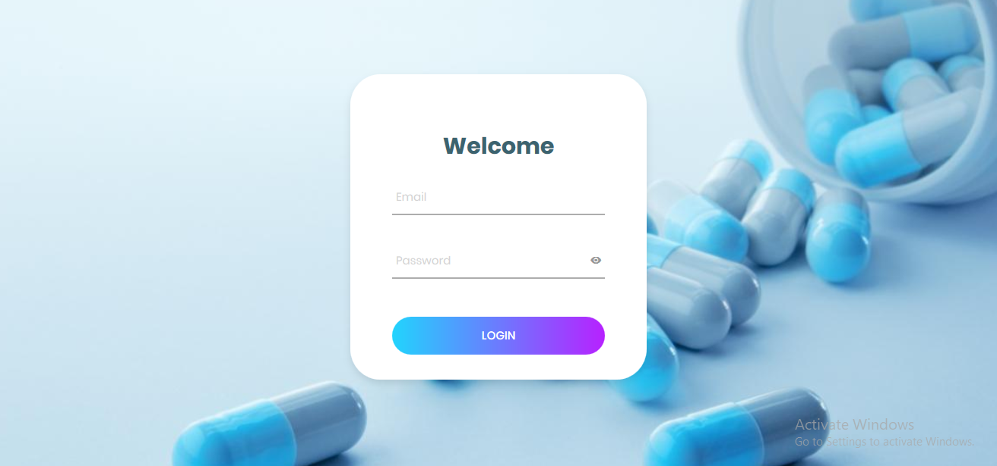
Admin login

Slide 9

Admin forms

Slide 10
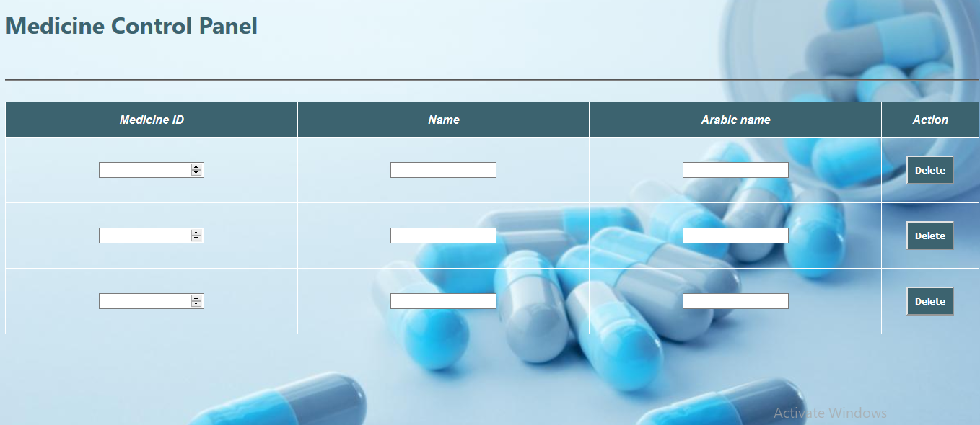
Medicine forms

Slide 11
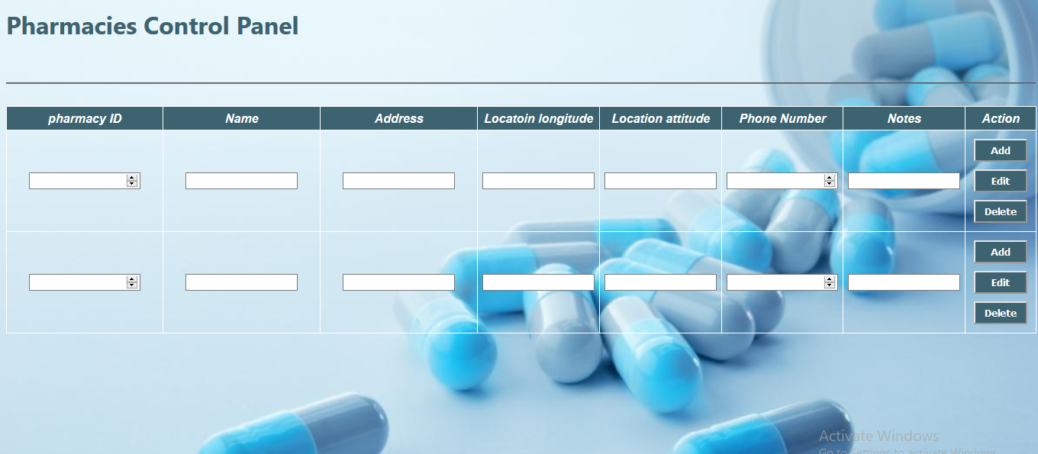
Pharmacies form

Slide 12
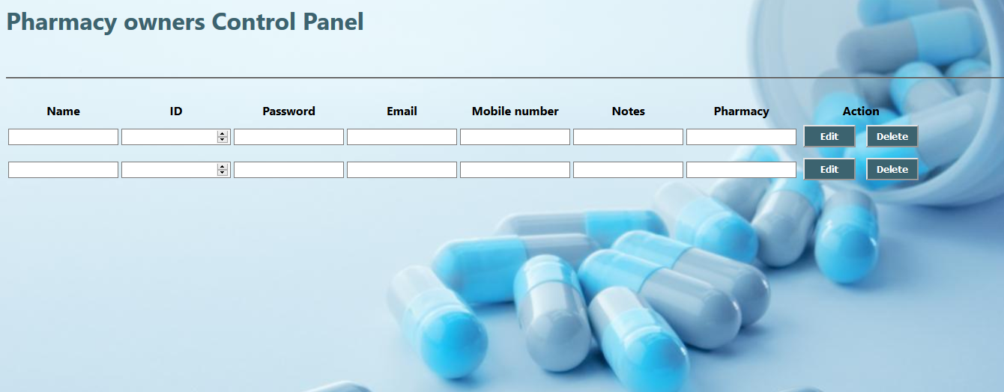
Pharmacy owners

Slide 13
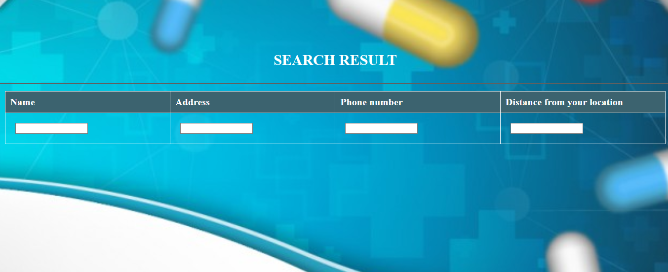
Search result

Slide 14
Project team members
Mostafa Elshazly
Yomna sabry
Nada kamal
Asmaa khamess

